Slide 1
Computer Graphics Environment Mapping
László Szécsi szecsi@iit.bme.hu
AIT

Slide 2
3D transformation vertex shader: world space position of vertex
.
before:
model space position vertexPosition
was multiplied by gameObject.modelMatrix to get world space position
then by camera.viewProjMatrix to project it to the screen
the above computation of gl_Position does not change
we still draw to the same location on screen
but we now need to use the world space position, which was formerly just an intermediate result
new VS output: out vec4 worldPosition;

Slide 3
3D transformation vertex shader: world space shading normal
!
VS should also take gameObject.modelMatrixInverse as a uniform
new VS output: out vec4 worldNormal;
worldNormal = gameObject.modelMatrixInverse * vec4(vertexNormal, 0);
this.modelMatrixInverse.set(this.modelMatrix).invert();

Slide 4


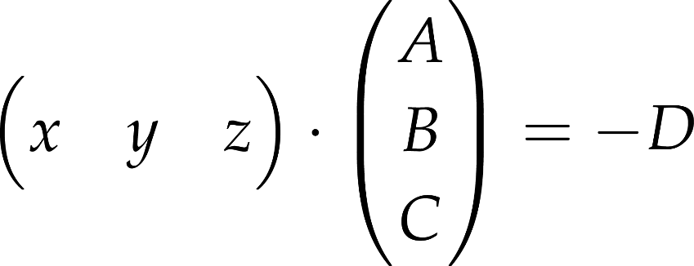

Why the inverse from the left? Part 1: the plane equation
explicit equation of a plane
where A, B, C are some numbers
can easily be rewritten into an implicit equation of the plane
with some other numbers A, B, C, D
a point x,y,z is in the plane if it fulfils equation
can be rewritten using the dot product as
plane normal

Slide 5
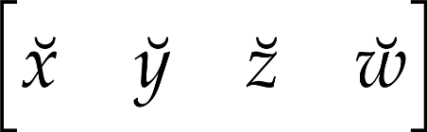
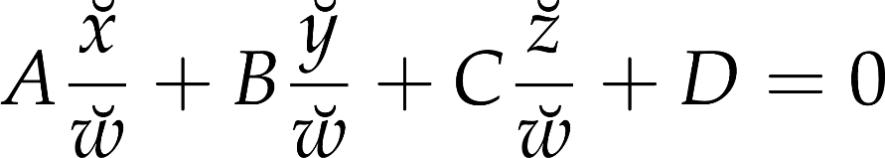


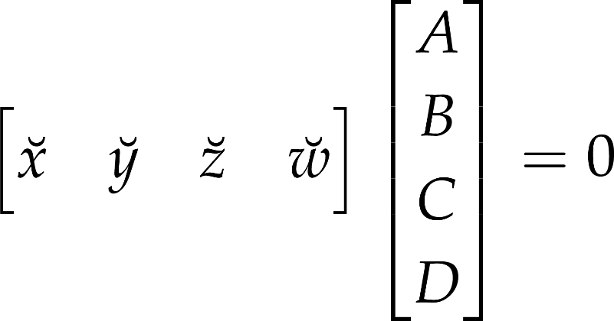
Why the inverse from the left? Part2: in homogeneous coordinates
Cartesian plane equation was
substituting homogeneous coordinates
multiplying by and allowing
can be written using a matrix product as
plane normal
with
plane offset from origin

Slide 6


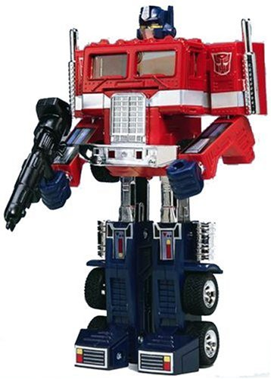



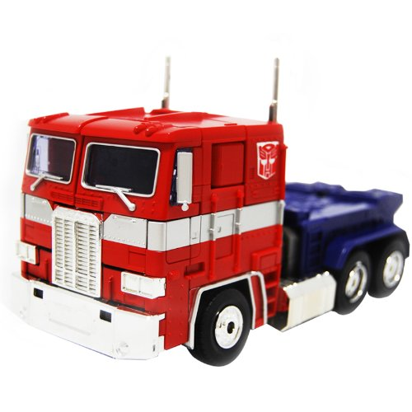
Why the inverse from the left? Part 3: invertible transformations
original shape
transformed shape

Slide 7
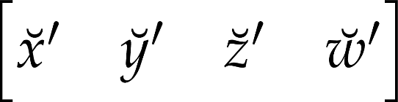
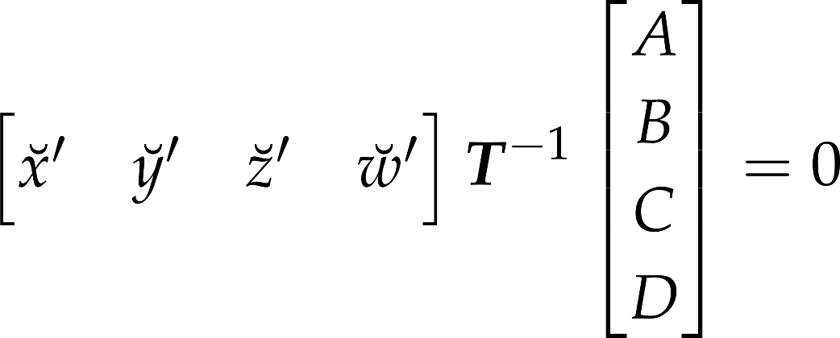
Why the inverse from the left? Part4: equation of the transformed plane
equation of the original shape is
point is on transformed shape, if, transformed back by the inverse, it is on the original
plane normal
with
plane offset from origin
of transformed plane

Slide 8
Fragment shader to verify 3D transformation
!
take the world-space normal from VS as input
normalize it
vec3 normal = normalize(worldNormal.xyz);
return vec4(abs(normal), 1) as color
false color display (visualizes non-color data as color)

Slide 9
Expected result
red, green, blue pokemon

Slide 10
Create env mapped object
!
create new FS (with a TexturedProgram and Material using it)
create TextureCube, set it to the material, create GameObject that uses a Mesh using the material
// must have a uniform variable like this
uniform samplerCube envmapTexture;
// compute vector from surface point to camera
vec3 viewDir = normalize(camera.worldPosition.xyz - worldPosition.xyz);
// use this function to sample texture with reflected direction
texture( envmapTexture, reflect(-viewDir, normal))
this.skyCubeTexture = new
TextureCube(gl, [
"media/posx.jpg",
"media/negx.jpg",
"media/posy.jpg",
"media/negy.jpg",
"media/posz.jpg",
"media/negz.jpg",]
);
this.slowpokeMaterial.
envmapTexture.set(
this.skyCubeTexture);

Slide 11
In case of object-relative camera
!
this.worldPosition.set(this.position).xyz1mul(this.parent.modelMatrix);
camera position is given in the model space of the parent object
we need to use the actual world space position for finding the view direction
must apply the parent’s model matrix and use transformed position
// compute vector from surface point to camera
vec3 viewDir = normalize(camera.worldPosition.xyz - worldPosition.xyz);

Slide 12
Expected result
mercury pokemon
reflects environment

Slide 13
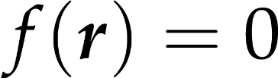
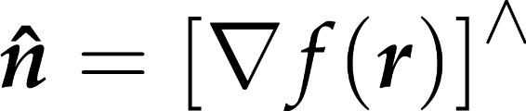

Procedural normal mapping
surface equation
surface normal formula
noise function
perturbed surface equation
thus: just add gradient-of-noise to quadric gradient, then normalize

Slide 14
Simple noise function and gradient
float noise(vec3 r) {
uvec3 s = uvec3(
0x1D4E1D4E,
0x58F958F9,
0x129F129F);
float f = 0.0;
for(int i=0; i<16; i++) {
vec3 sf =
vec3(s & uvec3(0xFFFF))
/ 65536.0 - vec3(0.5, 0.5, 0.5);
f += sin(dot(sf, r));
s = s >> 1;
}
return f / 32.0 + 0.5;
}
vec3 noiseGrad(vec3 r) {
uvec3 s = uvec3(
0x1D4E1D4E,
0x58F958F9,
0x129F129F);
vec3 f = vec3(0, 0, 0);
for(int i=0; i<16; i++) {
vec3 sf =
vec3(s & uvec3(0xFFFF))
/ 65536.0 - vec3(0.5, 0.5, 0.5);
f += cos(dot(sf, r)) * sf;
s = s >> 1;
}
return f;
}

